Slide 1


AIRBNB PRICE
PREDICTOR
Lab Group: FCEC Group 4
Khansa Putri Nugraha (U23202572K)
Odilia Kathleen Gunawan (U2321163G)

Slide 2
01
MOTIVATION
What made us start on Airbnb price analysis

Slide 3


Notes:
Look for airbnb articles, add problem statement, predictors and response

Slide 4
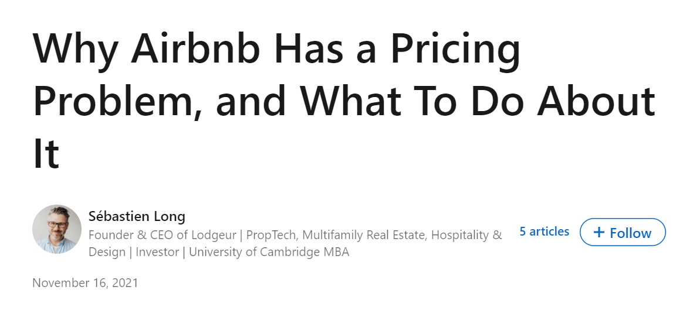
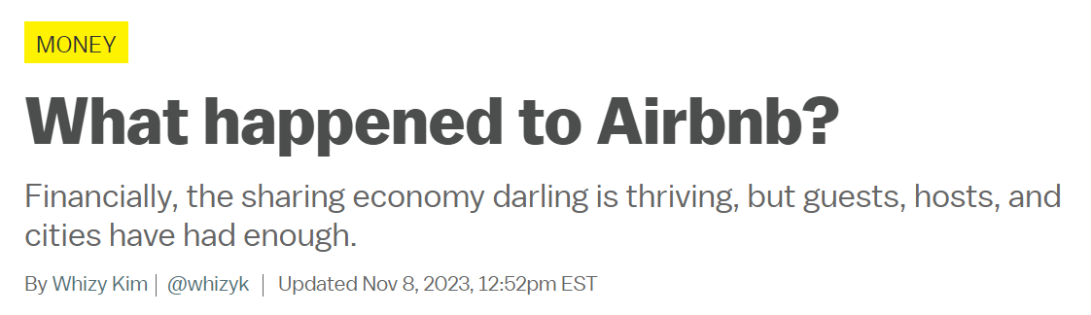
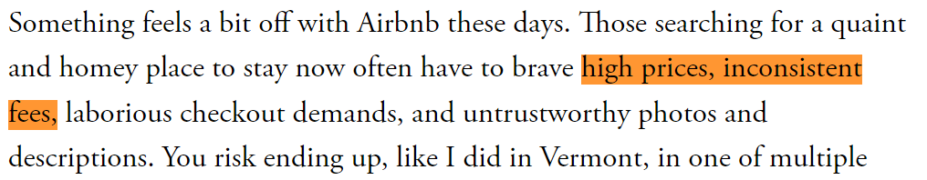
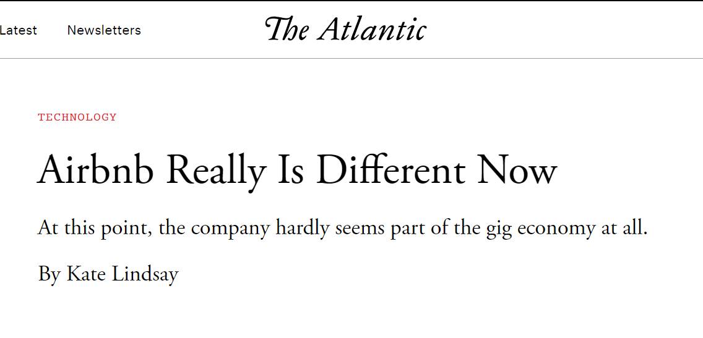
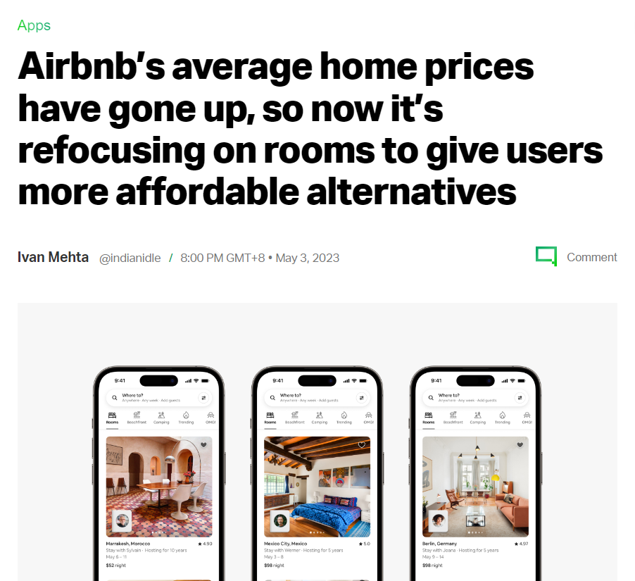
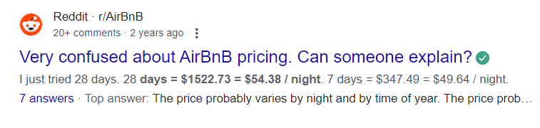
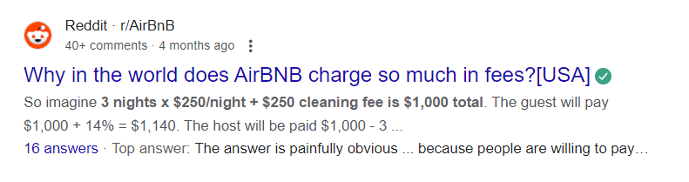
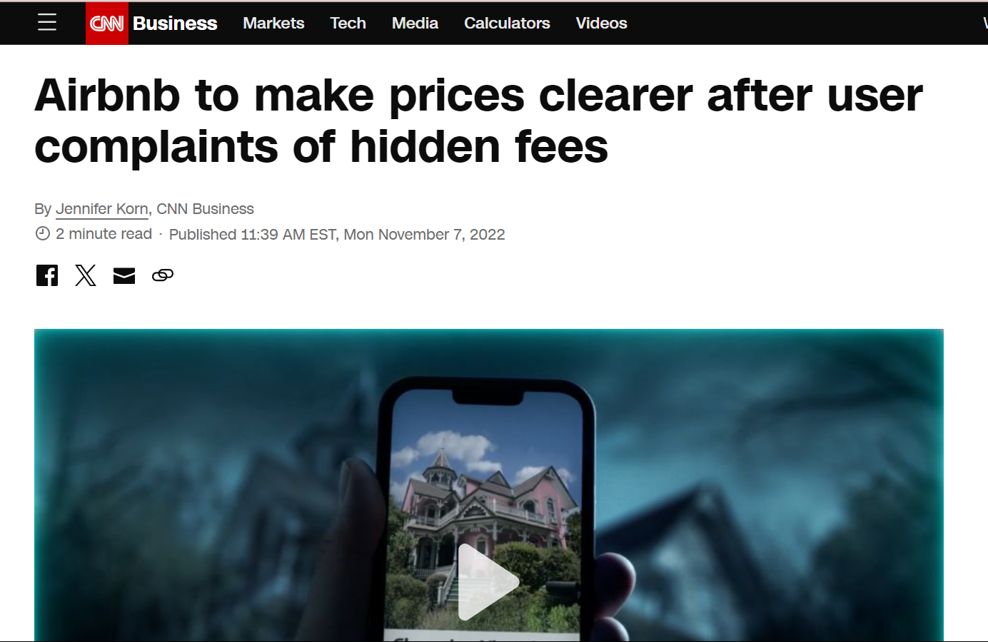

Slide 5
02
SETTING THE STAGE
Data Collection
Data Cleaning
Feature Engineering
EDA & Visualization

Slide 6
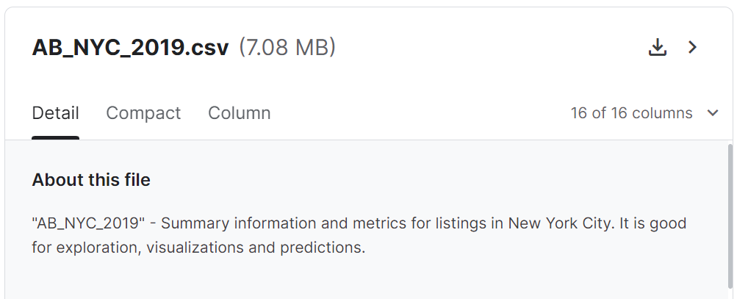
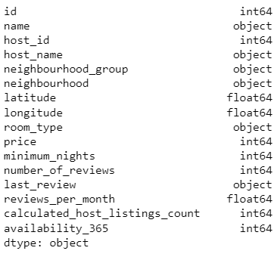
DATA COLLECTION

Slide 7
DATA PREPROCESSING
Data cleaning:
Dropping duplicates
Dropping unused columns
Dropping price outliers
Filling NaN values
Feature engineering:
distance_from_center
room_type_encoded (smaller space= 0, increasing to larger space)
neighbourhood_group_encoded (least popular = 0, increasing to most popular)
booking_density
availibility_ratio

Slide 8
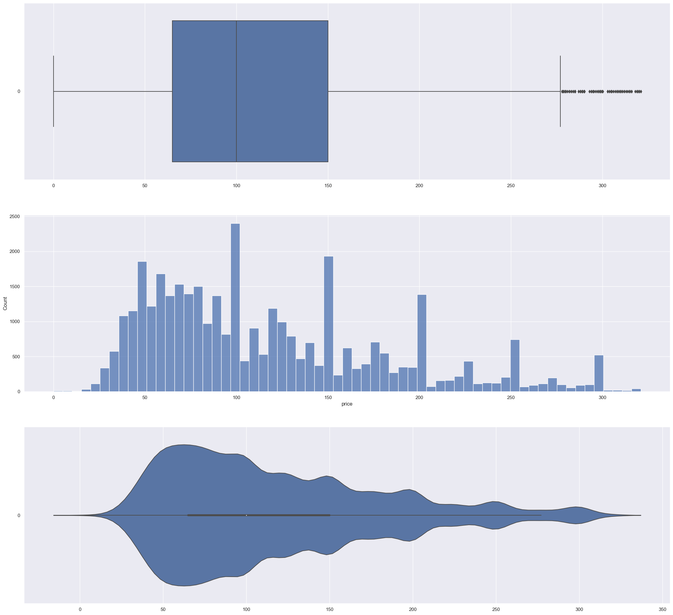
PRICE VARIABLE VISUALIZATION

Slide 9
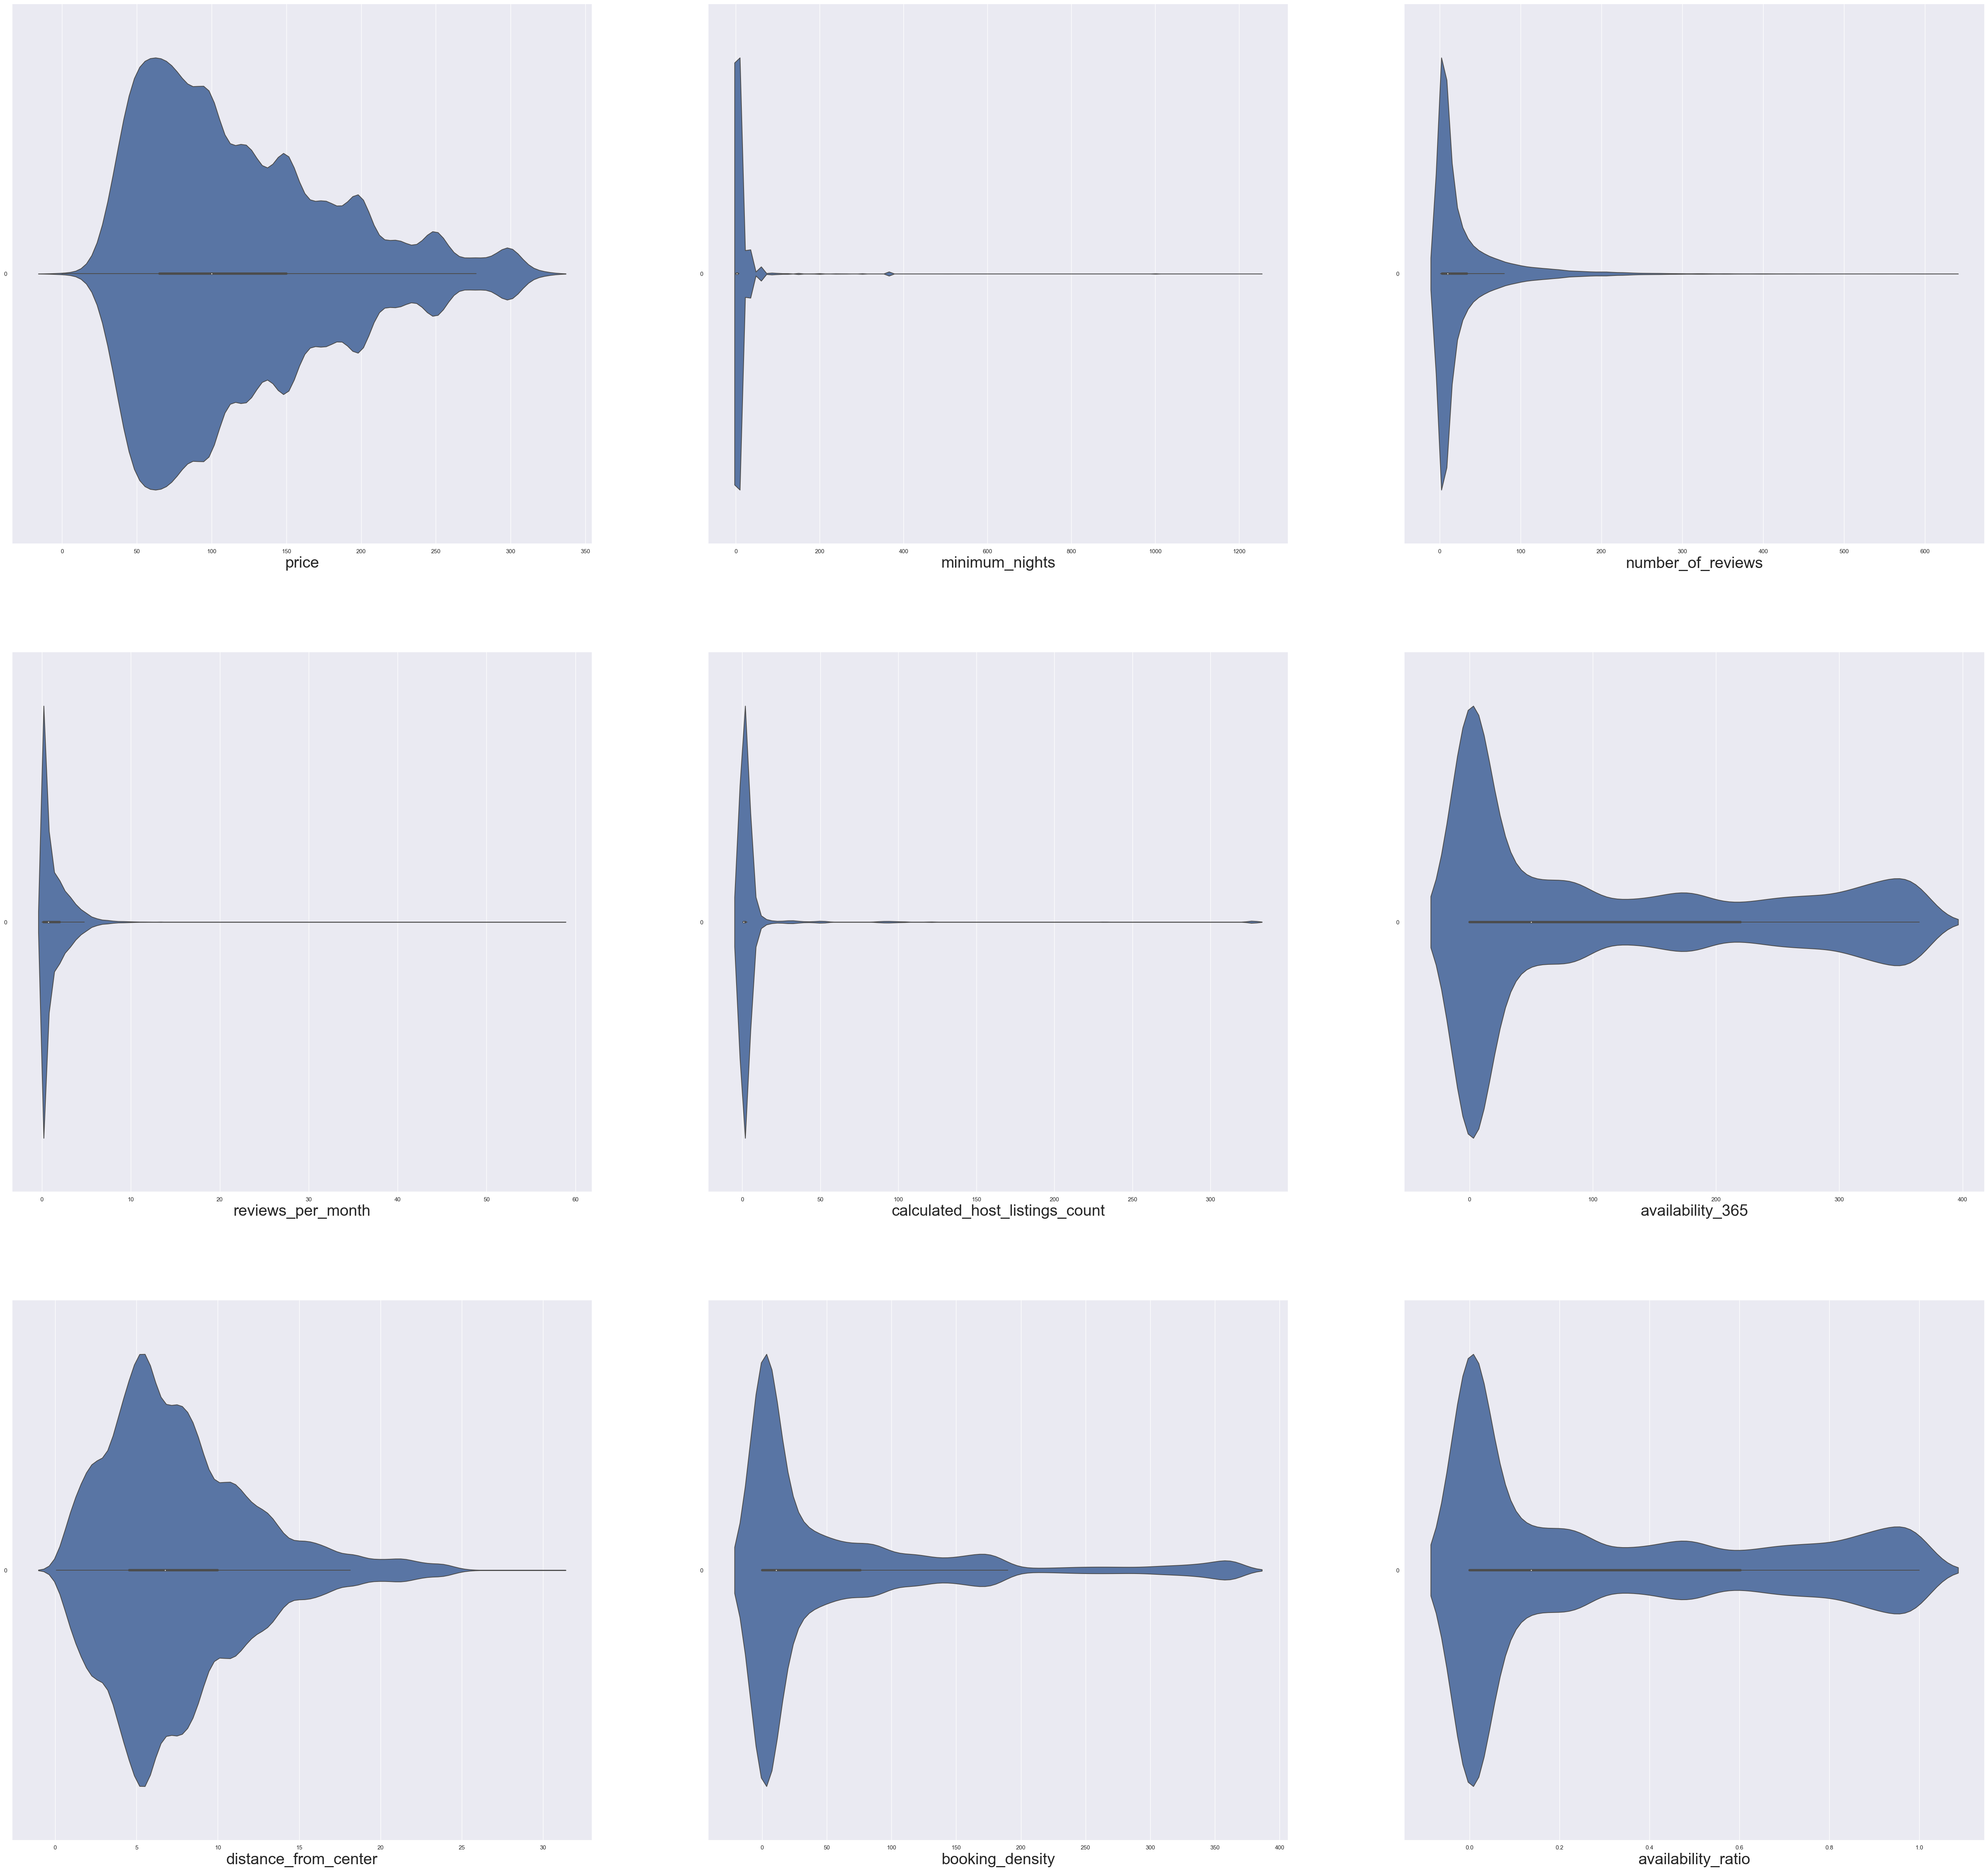
NUMERICAL DATA VISUALIZATION

Slide 10
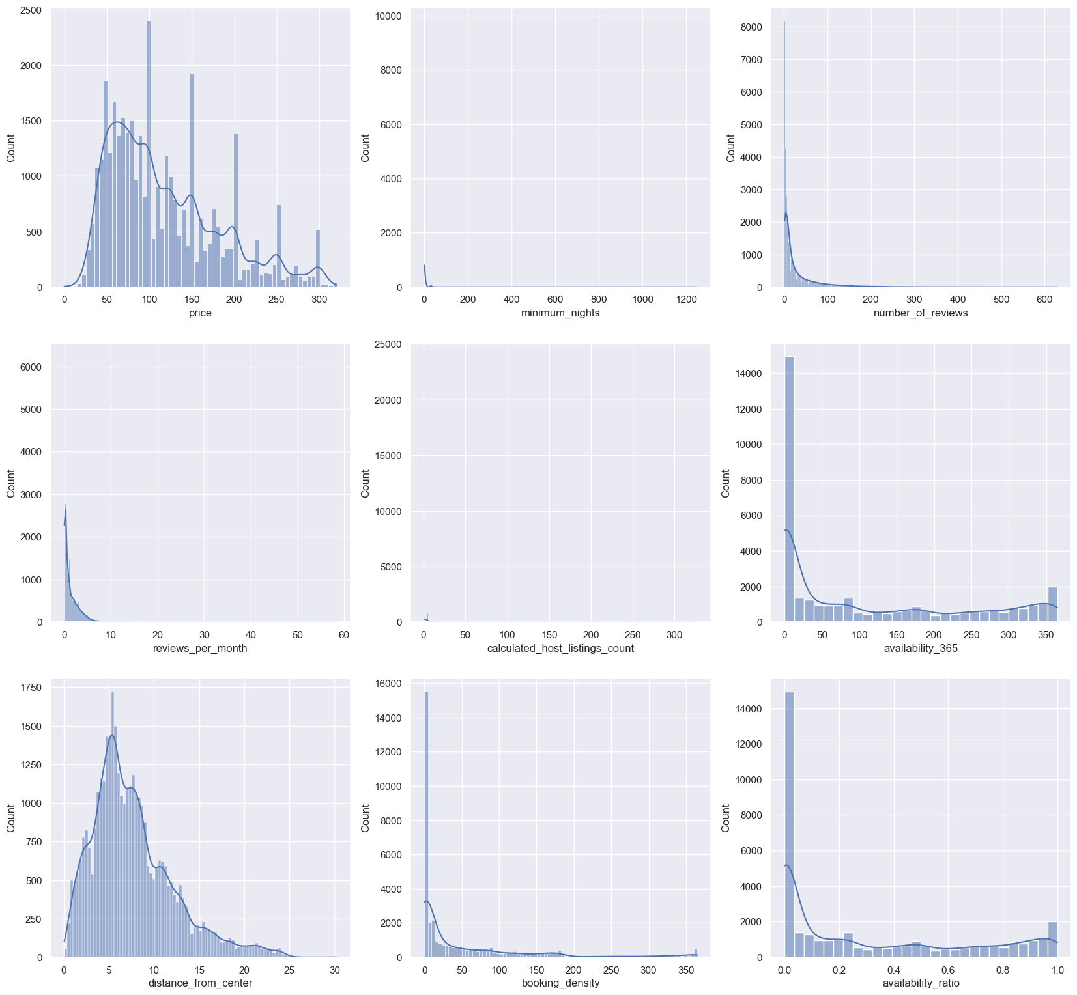
NUMERICAL DATA VISUALIZATION

Slide 11
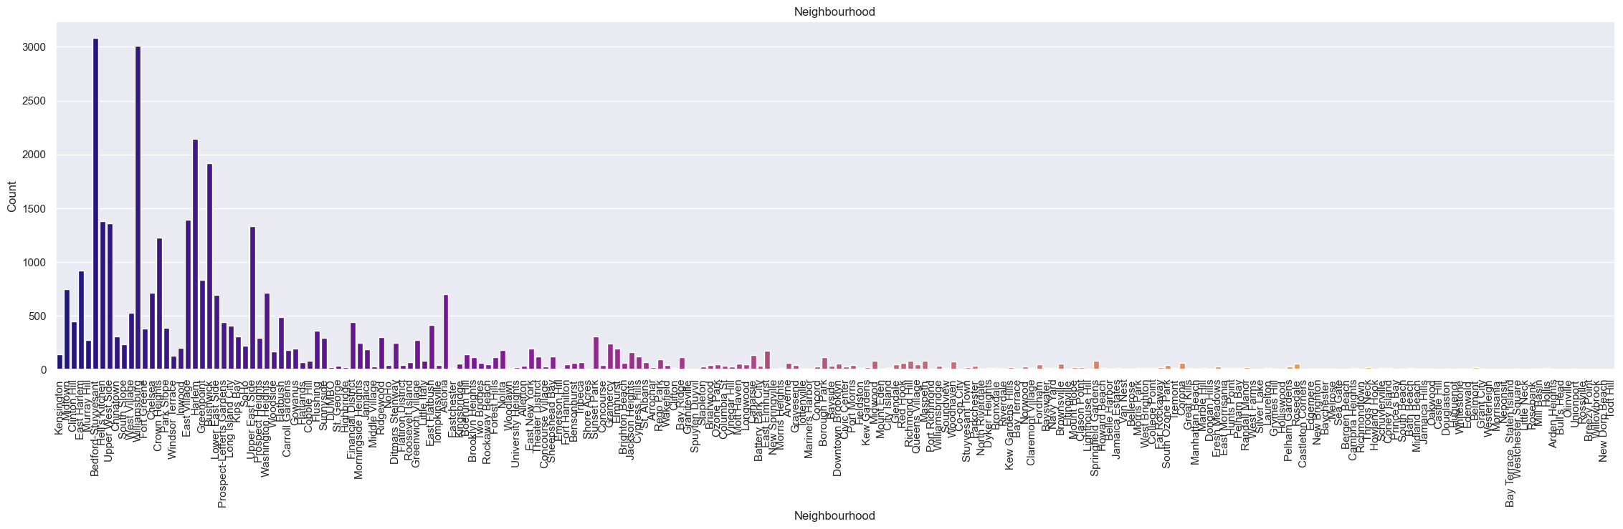
CATEGORICAL DATA VISUALIZATION

Slide 12
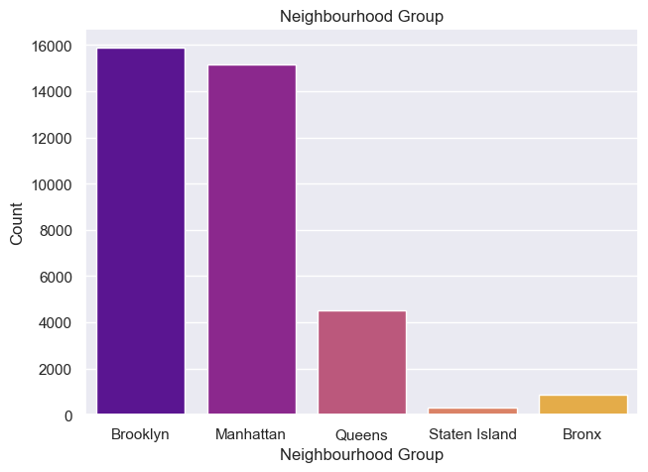
CATEGORICAL DATA VISUALIZATION

Slide 13
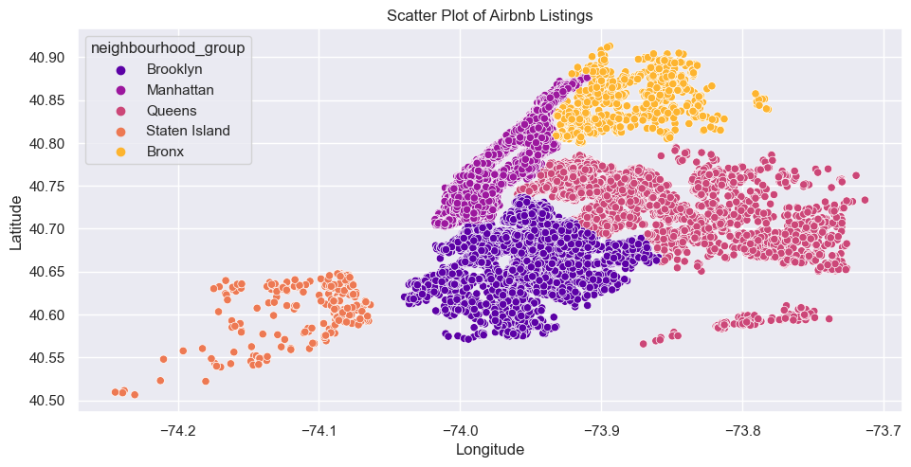
CATEGORICAL DATA VISUALIZATION

Slide 14
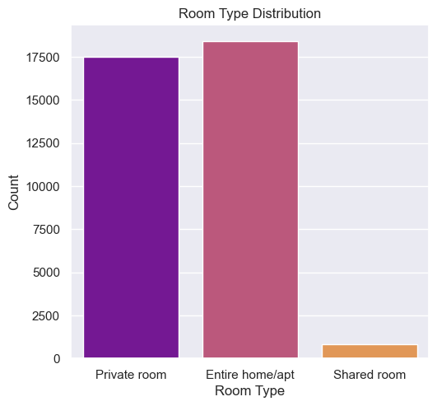
CATEGORICAL DATA VISUALIZATION

Slide 15
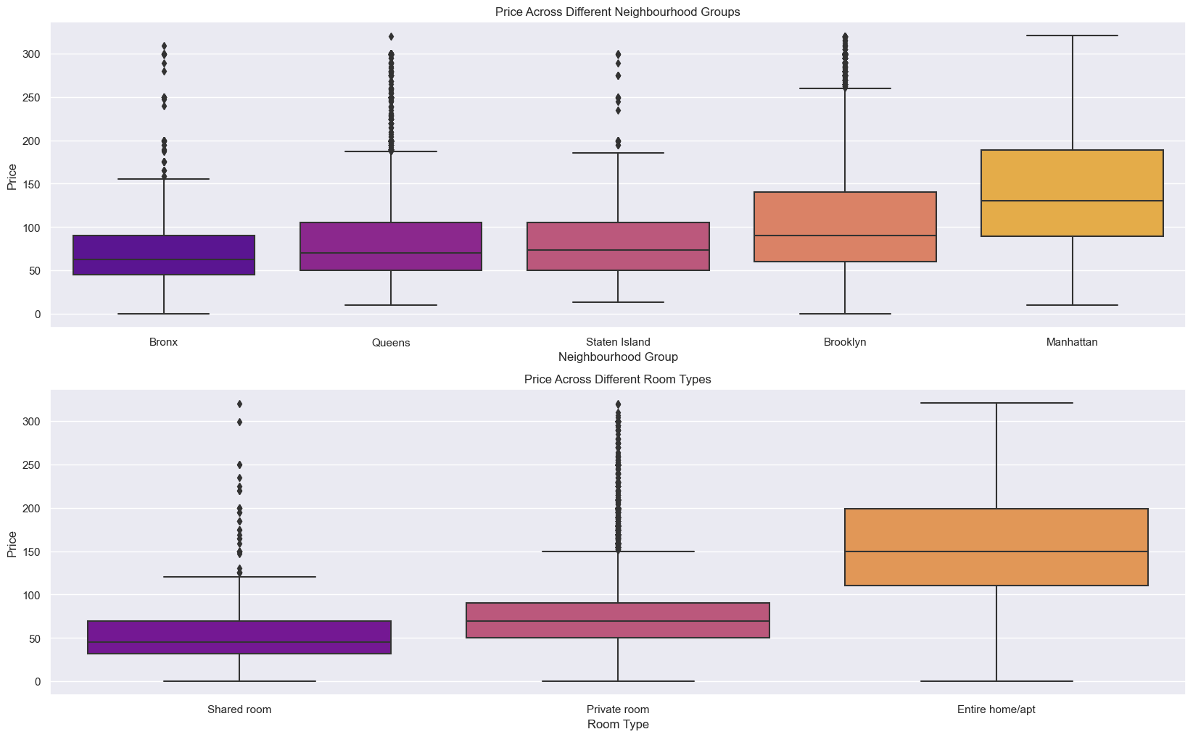
EXPLORATORY DATA ANALYSIS

Slide 16
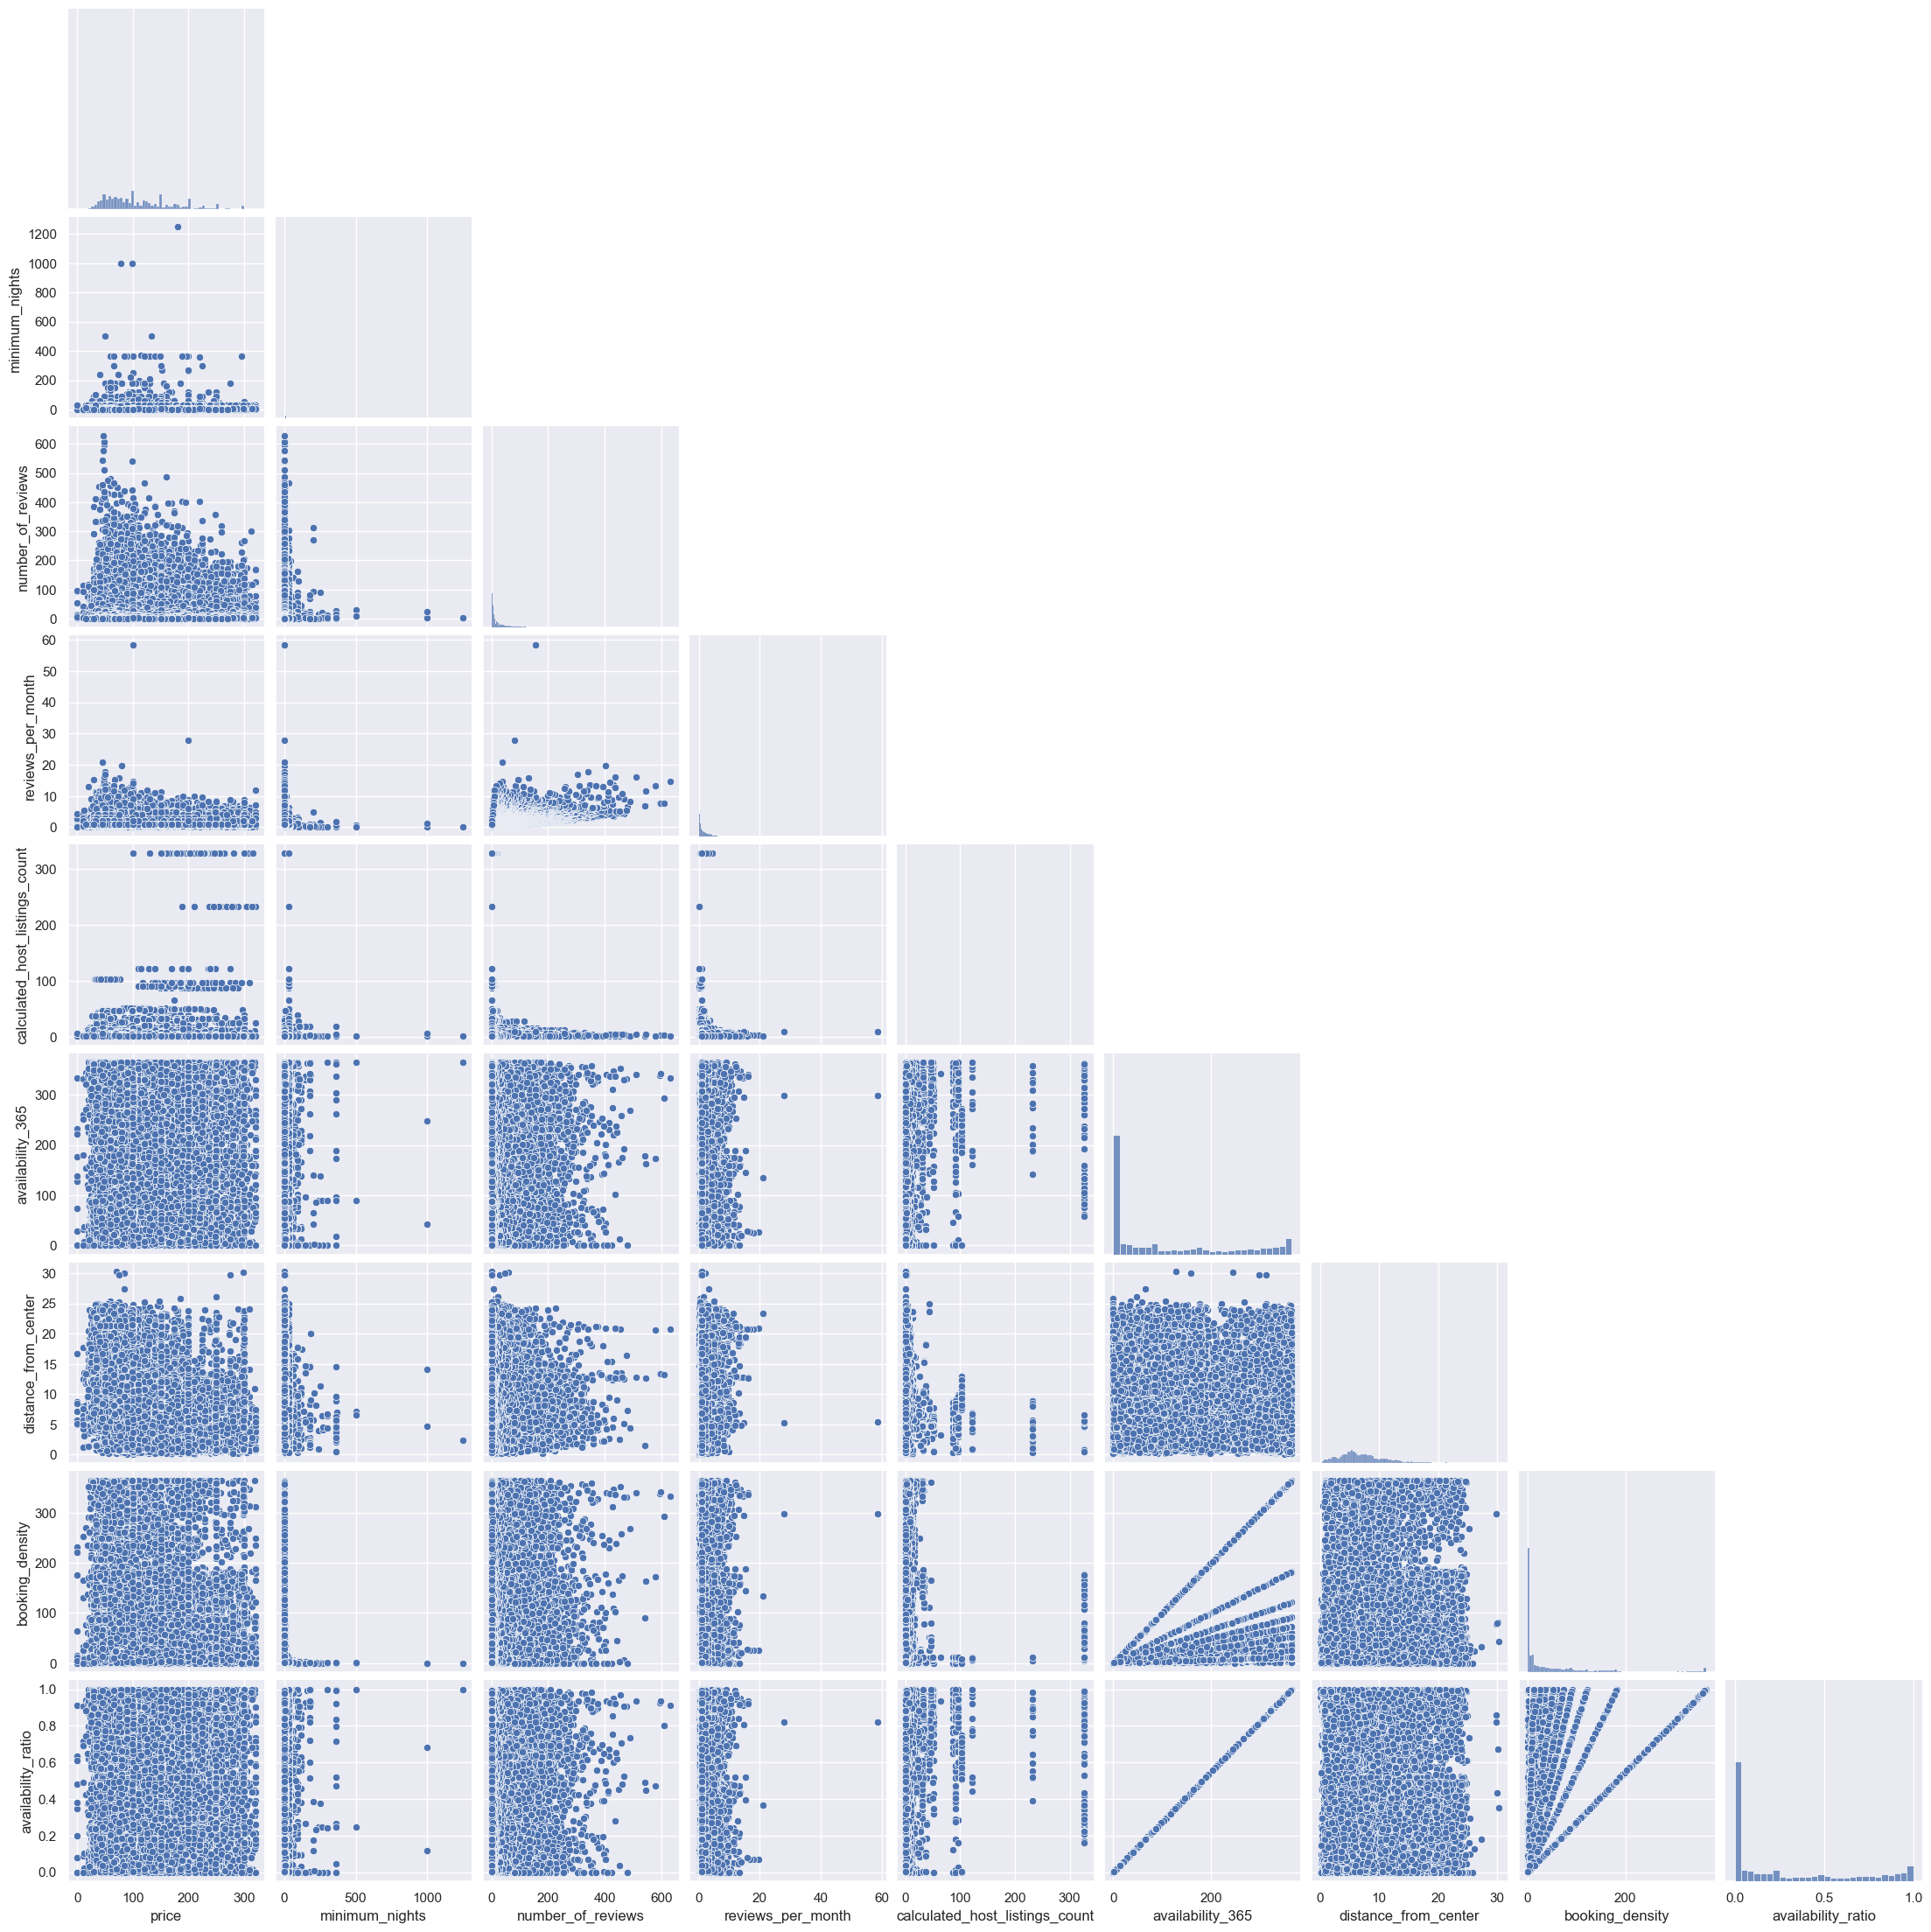
NUMERICAL DATA VISUALIZATION

Slide 17
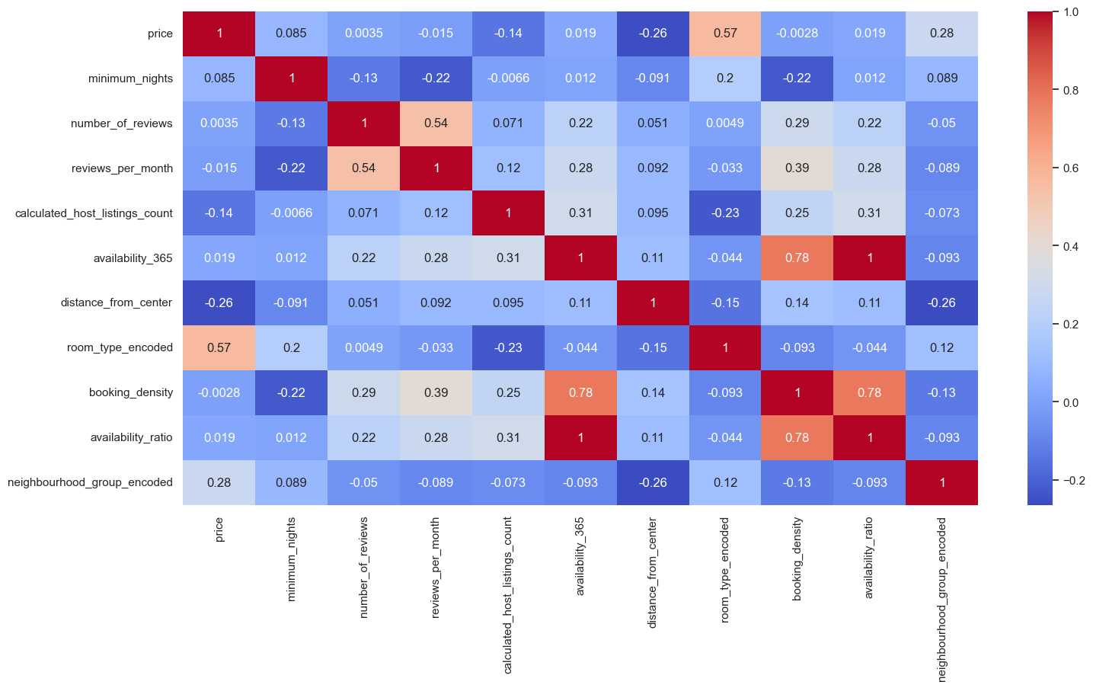
CORRELATION MATIRX
High positive correlation:
room_type_encoded
neighbourhood_encoded_type
High negative correlation:
distance_from_center

Slide 18
03
ANALYSIS
Data splitting
Data resampling
Machine learning model

Slide 19
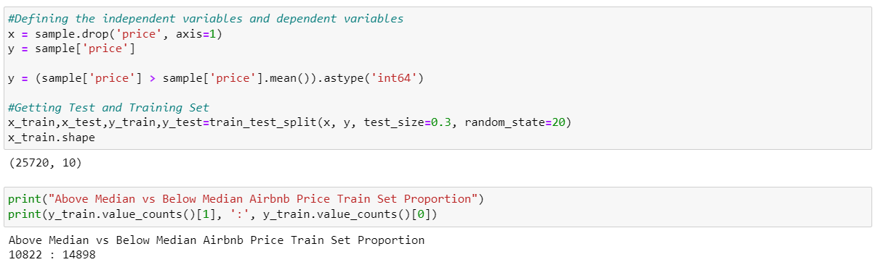
DATA SPLITTING

Slide 20
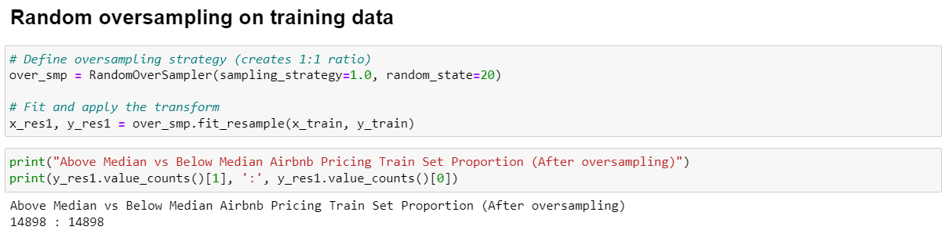
DATA RESAMPLING – RANDOM OVERSAMPLING

Slide 21
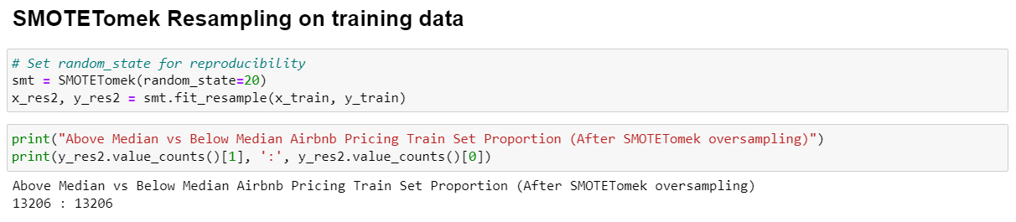
DATA RESAMPLING - SMOTETomek

Slide 22
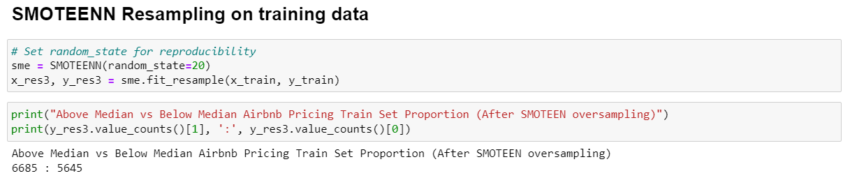
DATA RESAMPLING - SMOTEEN

Slide 23
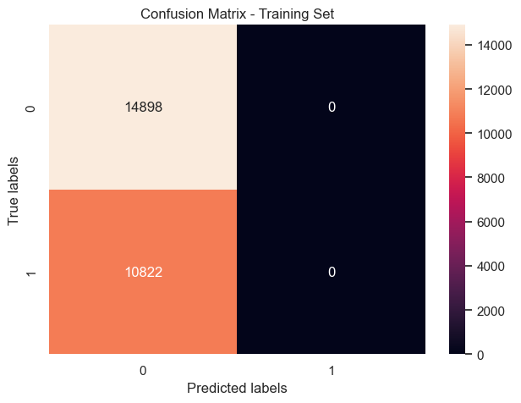
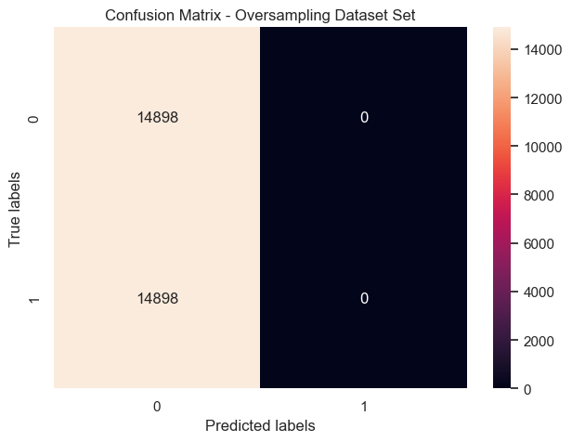
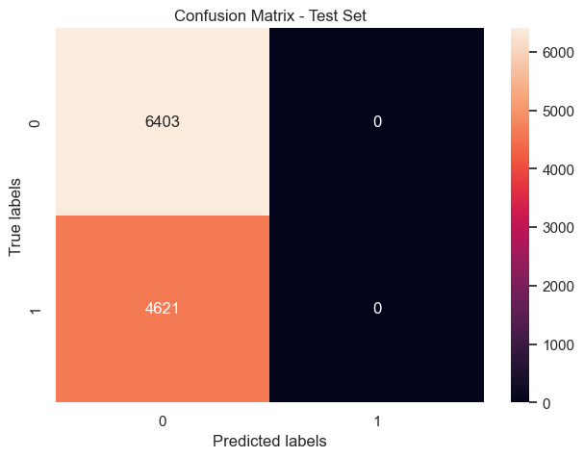
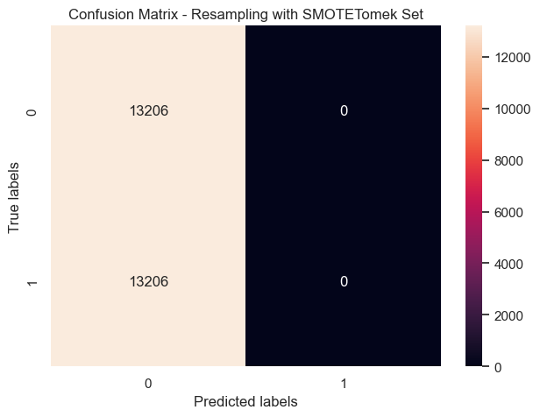
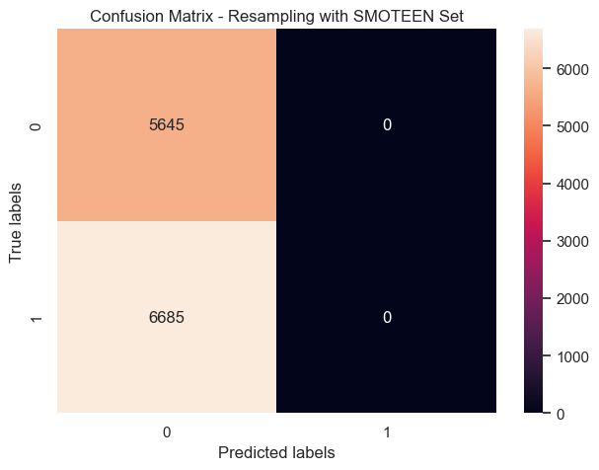
MODEL SELECTION - XGBoost

Slide 24
MODEL SELECTION - XGBoost
Training set:
Root Mean Squared Error on train : 0.42
Root Mean Squared Error on test : 0.42
Median Error Percentage : 47.32%
Error Margin : 0.42
Oversampling set:
Root Mean Squared Error on train : 0.42
Root Mean Squared Error on test : 0.51
Median Error Percentage : 40.15%
Error Margin : 0.42
SMOTETomek set:
Root Mean Squared Error on train : 0.42
Root Mean Squared Error on test : 0.51
Median Error Percentage : 39.30%
Error Margin : 0.42
SMOTEEN set:
Root Mean Squared Error on train : 0.35
Root Mean Squared Error on test : 0.53
Median Error Percentage : 48.18%
Error Margin : 0.54

Slide 25
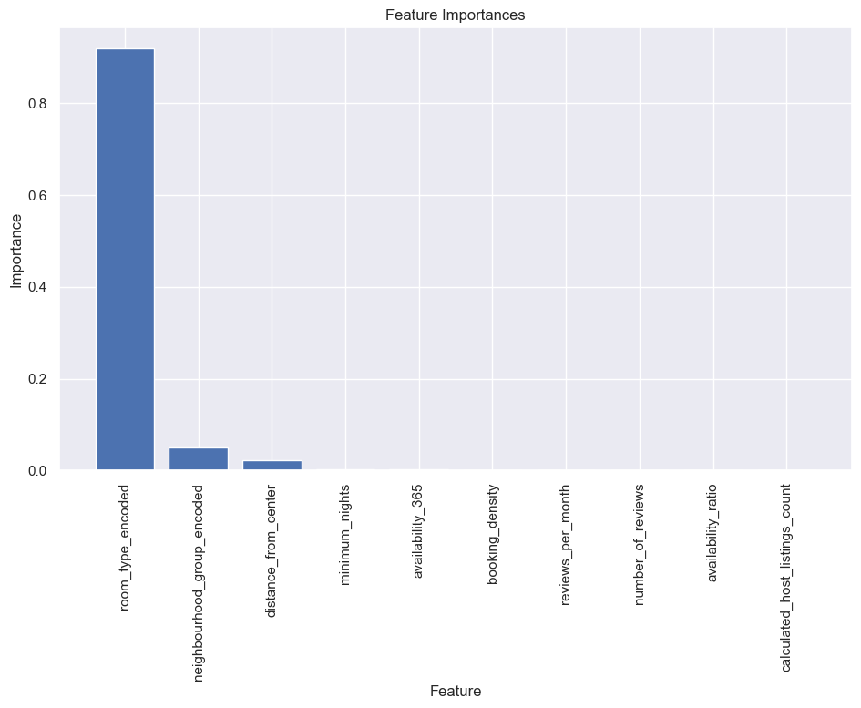
FEATURE IMPORTANCES- XGBoost
Important Features:
Room type
Neighbourhood group
Distance from city center

Slide 26
MODEL SELECTION - Random Forest Regression

Slide 27
MODEL SELECTION - Random Forest Regression
Training Set:
For train set:
Mean Squared Error (MSE) : 0.02
Root Mean Squared Error (RMSE) : 0.13
Median Error Percentage : 6.95 %
Error Margin : 0.13
For test set:
Mean Squared Error (MSE) : 0.37
Root Mean Squared Error (RMSE) : 0.61
Median Error Percentage : 69.0 %
Error Margin : 0.61
Oversampling set:
For train set:
Mean Squared Error (MSE) : 0.01
Root Mean Squared Error (RMSE) : 0.12
Median Error Percentage : 3.00%
Error Margin : 0.12
For test set:
Mean Squared Error (MSE) : 0.38
Root Mean Squared Error (RMSE) : 0.62
Median Error Percentage : 67.0%
Error Margin : 0.62

Slide 28
MODEL SELECTION - Random Forest Regression
SMOTETomeek Set:
For train set:
Mean Squared Error (MSE) : 0.02
Root Mean Squared Error (RMSE) : 0.12
Median Error Percentage : 4.36%
Error Margin : 0.12
For test set:
Mean Squared Error (MSE) : 0.38
Root Mean Squared Error (RMSE) : 0.62
Median Error Percentage : 62.0%
Error Margin : 0.62
SMOTEEN set:
For train set:
Mean Squared Error (MSE) : 0.01
Root Mean Squared Error (RMSE) : 0.07
Median Error Percentage : 0.0%
Error Margin : 0.07
For test set:
Mean Squared Error (MSE) : 0.38
Root Mean Squared Error (RMSE) : 0.62
Median Error Percentage : 62.0%
Error Margin : 0.62

Slide 29
AFTER HYPERPARAMETER TUNING

Slide 30
AFTER HYPERPARAMETER TUNING
Training Set:
For train set: Mean Squared Error (MSE) : 0.12 Root Mean Squared Error (RMSE) : 0.35 Median Error Percentage : 19.68% Error Margin : 0.35 For test set: Mean Squared Error (MSE) : 0.36 Root Mean Squared Error (RMSE) : 0.61 Median Error Percentage : 61.62% Error Margin : 0.61
Oversampling set:
For train set:
Mean Squared Error (MSE) : 0.13
Root Mean Squared Error (RMSE) : 0.35
Median Error Percentage : 15.81%
Error Margin : 0.35
For test set:
Mean Squared Error (MSE) : 0.36
Root Mean Squared Error (RMSE) : 0.61
Median Error Percentage : 55.19%
Error Margin : 0.61

Slide 31
AFTER HYPERPARAMETER TUNING
SMOTETomeek set:
For train set:
Mean Squared Error (MSE) : 0.10
Root Mean Squared Error (RMSE) : 0.32
Median Error Percentage : 12.16%
Error Margin : 0.32
For test set:
Mean Squared Error (MSE) : 0.38
Root Mean Squared Error (RMSE) : 0.61
Median Error Percentage : 59.08%
Error Margin : 0.61
SMOTEEN set:
For test set:
Mean Squared Error (MSE) : 0.04
Root Mean Squared Error (RMSE) : 0.21
Median Error Percentage : 1.39%
Error Margin : 0.21
For test set:
Mean Squared Error (MSE) : 0.38
Root Mean Squared Error (RMSE) : 0.61
Median Error Percentage : 59.08%
Error Margin : 0.61

Slide 32
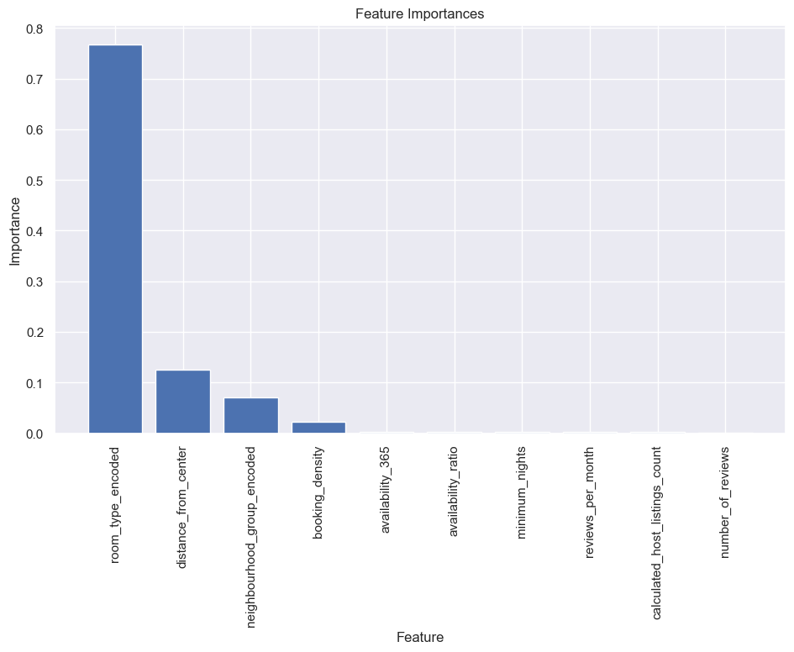
FEATURE IMPORTANCES - Random Forest
Important Features:
Room type
Neighbourhood group
Distance from city center
Booking density

Slide 33
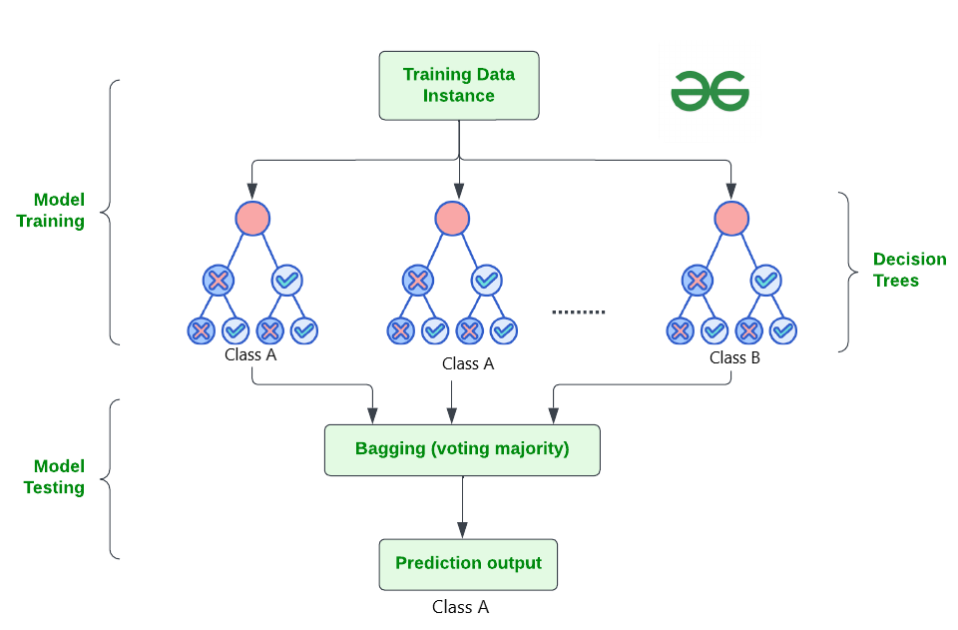
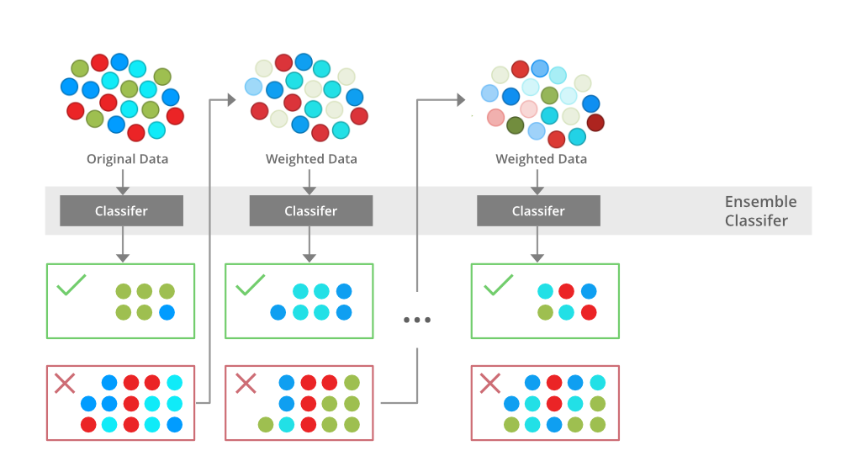
MODEL COMPARISON
Random Forest Regression
XGBoost

Slide 34
04
PROJECT OUTCOMES
Learning points

Slide 35
DATA-DRIVEN INSIGHTS
Room type
Neighbourhood groups
Distance from city centre
Booking density
Notes:
Room type – most important factor
Neighbourhood – big factor
No of reviews – not very impactful
Distance – surprisingly not a high correlation unlike neighbourhood

Slide 36


LEARNING POINTS
Data cleaning
Cleaning, tuning, and making sure the data is suitable
Model selection
Which model is most accurate and appropriate?
Learn from EDA
Discard potential noise that will make the prediction process more complex
Adjustment
Applying limitations like hyperparameter tuning can increase accuracy

Slide 37
OUR PROJECT CONCLUSION
Collaboration | Using GitHub Effective communication Task distribution
Exploration | Researching methods Trial-and-error Problem formulation
Analysis | Model selection Hyperparameter tuning Forming a conclusion
Notes:
What we can conclude after the project

Slide 38


THANKS!
Please keep this slide for attribution

